Slide 1
The influence of Low Impact Development on rainfall-runoff relationships at catchment scale
Xinxin Sui
MSc Water Management 2017-2019
TU Delft

Slide 2
The influence of Low Impact Development on rainfall-runoff relationships at catchment scale
Introduction
Modelling
Scenarios
Results
Discussions
Conclusions
Recommendations

Slide 3
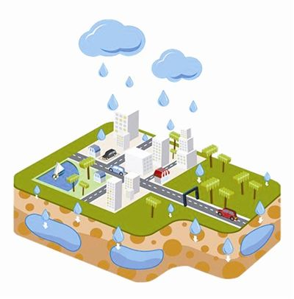
Introduction
Conventional development (CD: disturbance of nature)
→urban water problems
Low Impact Development (mimic nature)
→solve water problems
Low Impact Development
Problem statement
Research approach
Study area
Data
Notes:
LID, solve problem by TD; disturbance; concrete, asphalt, remove soil, cut trees, (dry/flood), water quality; LID Green, Blue e.g. green roof, pervious pavement; decrease impact of urban construction, at a stable level

Slide 4
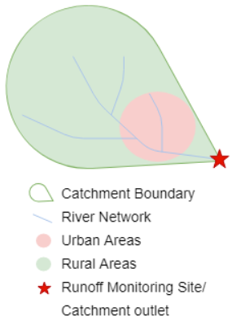
Introduction
Low Impact Development
Problem statement
Research approach
Study area
Data
LID seems to decrease runoff
Flood risk: Delayed function of LID→ The approaching of urban and rural peak times → more stacking of urban and rural peaks and larger total peak
Trend of Urbanization
Notes:
Delayed function of LID, peak times approach, which cause more stacking

Slide 5
Introduction
Main Q: Explore the impact of LID implementation with regard to peak runoff value on the catchment scale
Q1: The different hydrologic characters of urban and rural areas;
Q2: The urbanization influence on rainfall-runoff relationship on catchment scale;
Q3: The LID implementation influence on rainfall-runoff relationship on catchment scale;
Q4: The problem caused by the time approaching and stacking of peak flows from urban and rural areas due to LID;
To deal with the prediction uncertainty, scenario analysis is used to give a reliable answer to the research question.
Low Impact Development
Problem statement
Research approach
Study area
Data

Slide 6
Introduction
Low Impact Development
Problem statement
Research approach
Study area
Data
This project will exploit conceptual hydrological model with SUPERFLEX model framework to simulate one real catchment under three different conditions.
Current CD situation
Urbanized CD situation under 3 urbanization scenarios (without LID practices)
Urbanized LID situation under 5 LID implementation scenarios

Slide 7
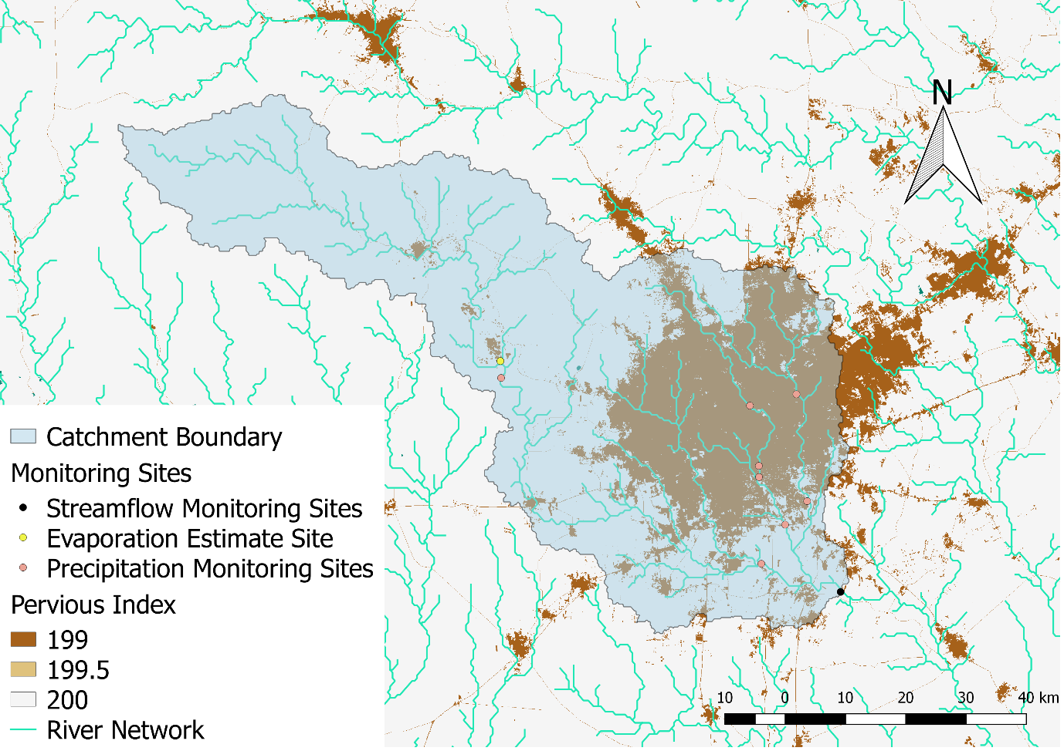
Introduction
Low Impact Development
Problem statement
Research approach
Study area
Data
Location: San Antonio city in Texas state, U.S. (29.424349; -98.491142)
Area: 4544 km² (Rural, 73%; Urban 27%)
Condition: The position of urban areas

Slide 8
Introduction
Low Impact Development
Problem statement
Research approach
Study area
Data
Social condition: the seventh most populous city in the U.S. with 1.5 million residents (2017)
Climate: transitional humid subtropical climate (Winters may pass without any frozen precipitation at all)
Geology: moderately permeable deep clayey soils and marls
Urban water system: separate sewer and stormwater systems

Slide 9
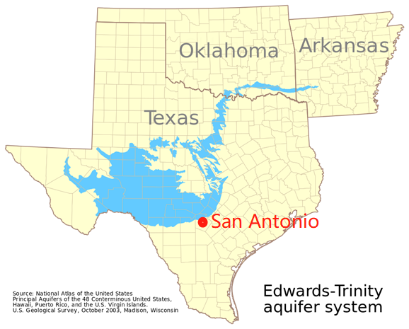
Introduction
Low Impact Development
Problem statement
Research approach
Study area
Data
Figure. The distribution area of Edwards Aquifer and the location of San Antonio City (Resources: Wikipedia)
Geohydrology: prolific Edwards Aquifer provides the urban usage water for San Antonio City; recharge project in contribution zone (in north part of San Antonio City)

Slide 10
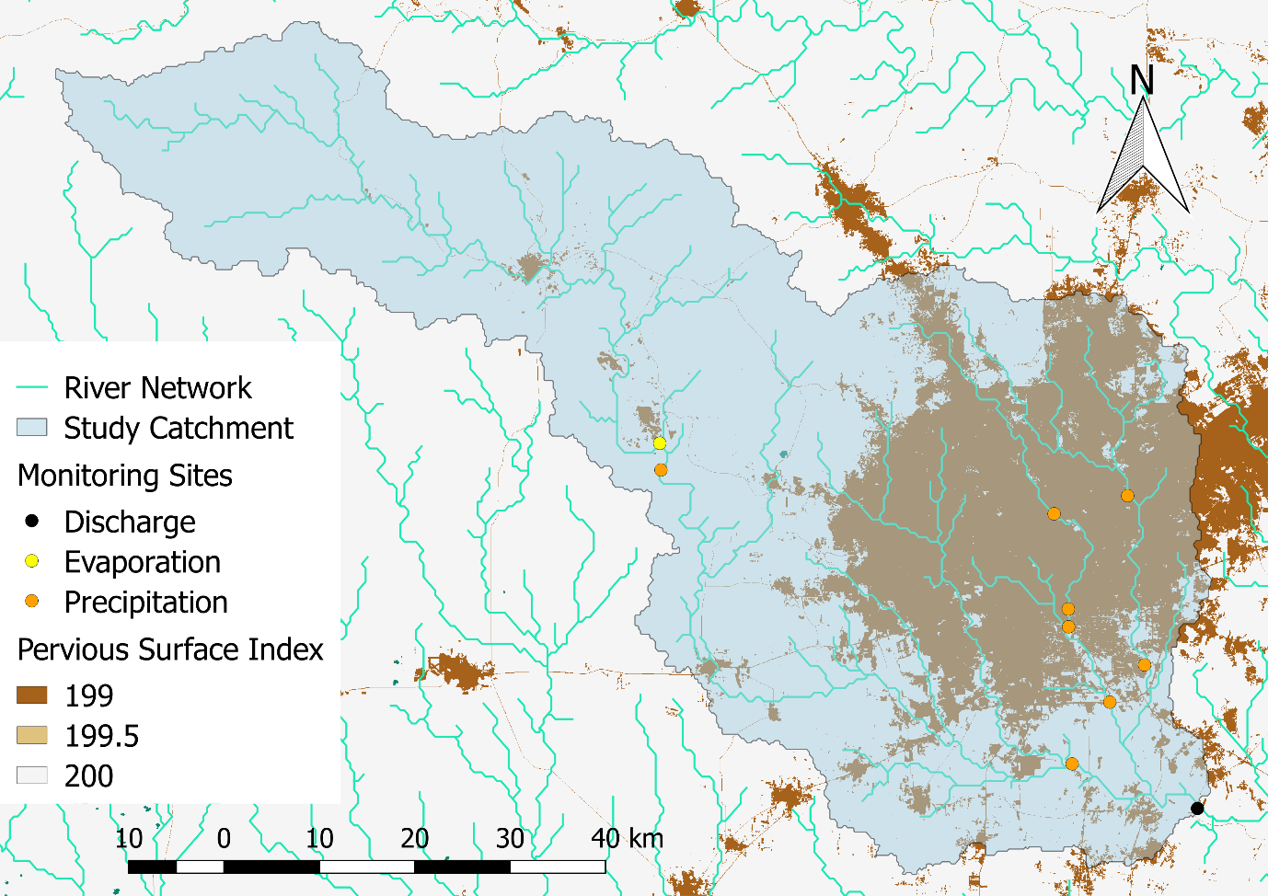
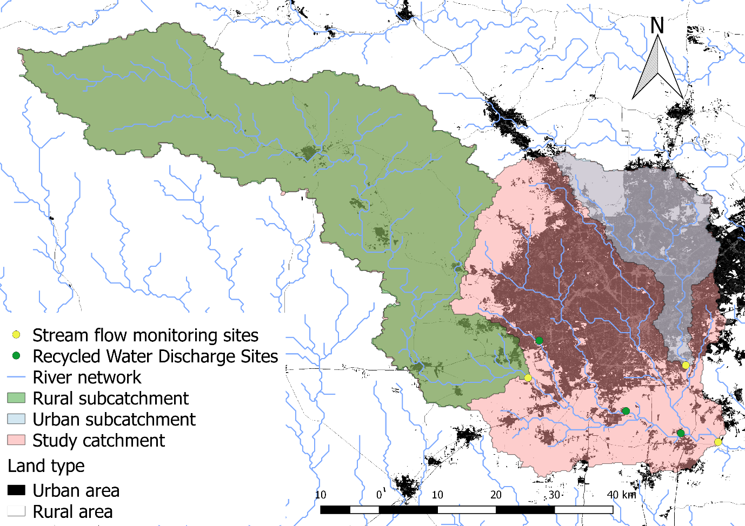
Introduction
Low Impact Development
Problem statement
Research approach
Study area
Data
Type: Precipitation; Discharge; Evaporation
Available period: 2017-04-12 to 2018-12-02 (600 days)
Time scale: 30 minutes (The number of data = 28800)
Resources: USGS website

Slide 11
The influence of Low Impact Development on rainfall-runoff relationships at catchment scale
Introduction
Methodology
Modelling
Scenarios
Results
Discussions
Conclusions and recommendations

Slide 12
Methodology
Conceptual versus physical-based model: to reduce the equifinality and model uncertainty problems; low data requirement
Semi-distributed versus distributed model: more simple model, to reduce the equifinality and model uncertainty problems
Flexible framework versus fixed model structure: identify the dominant hydrological process and understand the hydrological condition by hypothesizing, building, and testing different model structures; tailor-made model can fit the condition of study catchment as much as possible.
Final selection: SUPERFLEX framework
Rainfall-runoff model selection
Modelling Strategy
The expression of LID in model

Slide 13
Methodology
Strategy of model structure design: start from two lumped models
Parameter calibration method:
Period: all 600 days for two sub-catchments and the first 365 days of study catchment;
Objective function: Nash Sutcliffe Efficiency (NSE) and correlation coefficient (R2);
Creating parameter set: Monte Carlo method; More complex models with more parameters will have more set of parameter samples to seek a “fair” calibration scale
For the semi-distributed models, some constraints on the rural and urban parameters will be exploited to avoid unrealistic combinations of parameters
(Rainfall-runoff model selection)
Modelling Strategy
The expression of LID in model

Slide 14
Methodology
3. Model components or model selection strategy
For lumped models:
dominant water process;
effective and efficient components;
For semi-distributed models:
accuracy and precision (selecting model structure)
performance of rural and urban sub-flows and peak flow simulation (selecting parameter set)
distribution comparison (QQ plot) of observed data and model result (selecting parameter set)
(Rainfall-runoff model selection)
Modelling Strategy
The expression of LID in model

Slide 15
Methodology
(Rainfall-runoff model selection)
Modelling Strategy
The expression of LID in model
Qualitative hydrologic routes design: hydrologic functions, e.g. infiltration or transpiration;
Quantitative parameters estimation: relevant literature, realistic field test results, and local government files of LID practices.

Slide 16
The influence of Low Impact Development on rainfall-runoff relationships at catchment scale
Introduction
Modelling
Scenarios
Results
Discussions
Conclusions
Recommendations

Slide 17

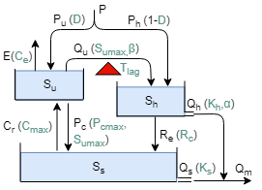
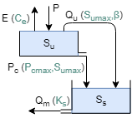
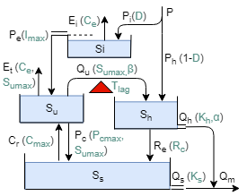
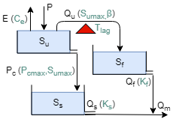
Modelling
a. Urban lumped model development (for urban sub-catchment)
Lumped models for rural and urban sub-catchments
Semi-distributed model for study catchment
The expression of LID practices in model
M01
 |  | M04
M02
 |  | M05
M03
Human impact Reservoir
Slow groundwater Reservoir
Interception Reservoir
Fast groundwater Reservoir
Notes:
Bucket as basic model framework is tested among different model generations; among the several models in one generation, different hydrological processes and constitutive functions are tested

Slide 18
Modelling
a. Urban lumped model development (M04 as example)
Lumped models for rural and urban sub-catchments
Semi-distributed model for study catchment
The expression of LID practices in model
M04A |  | M04C
M04B
 |  | M04D
Alpha:
discharge coefficient
D:
precipitation distribution coefficient
Cr:
Capillary rise
Notes:
Bucket as basic model framework is tested among different model generations; among the several models in one generation, different hydrological processes and constitutive functions are tested

Slide 19
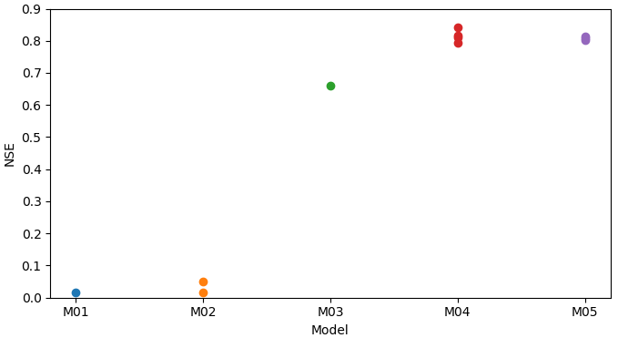
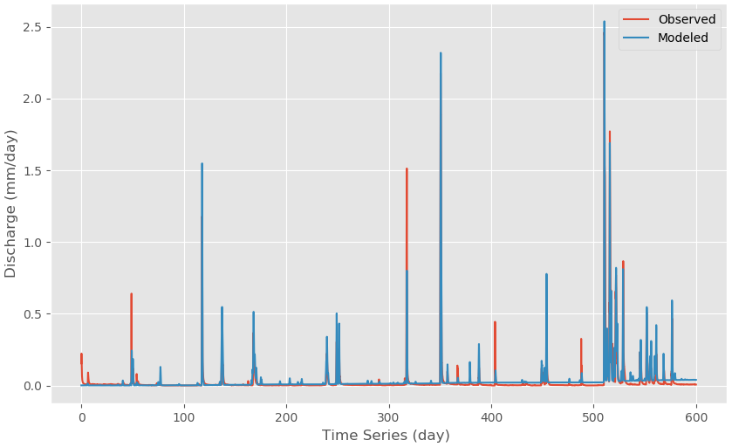
Modelling
b. Urban lumped model result
Lumped models for rural and urban sub-catchments
Semi-distributed model for study catchment
The expression of LID practices in model
Figure 12. Model Result of Urban Lumped M05B

Slide 20
Modelling
c. Model components selection: dominant; effective and efficient
Lumped models for rural and urban sub-catchments
Semi-distributed model for study catchment
The expression of LID practices in model
By comparing 5 generations of model structure:
“Unsaturated Reservoir-Slow groundwater Reservoir-Human impact Reservoir” three buckets as basic model framework;
Although Interception Reservoir does not have positive effect on the NSE, the model performance on peak runoff simulation is improved.
By comparing different model structures of one generation:
Capillary rise (Cr);
Discharge exponent (α);
Precipitation distribution factor (D);

Slide 21
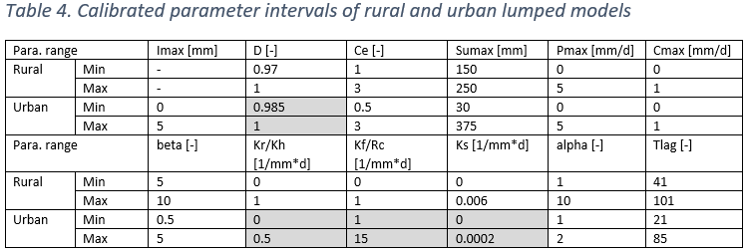
Modelling
d. Parameter calibration of lumped model
- Determine initial parameter intervals in semi-distributed model
Lumped models for rural and urban sub-catchments
Semi-distributed model for study catchment
The expression of LID practices in model
parameter intervals, rather than specific parameter value;
Notes:
No specific parameter value would be selected from this calibration result but the parameter intervals, which could capture the objective function larger than 0.6, were reserved and used to determine the initial parameter interval in semi-distributed model

Slide 22
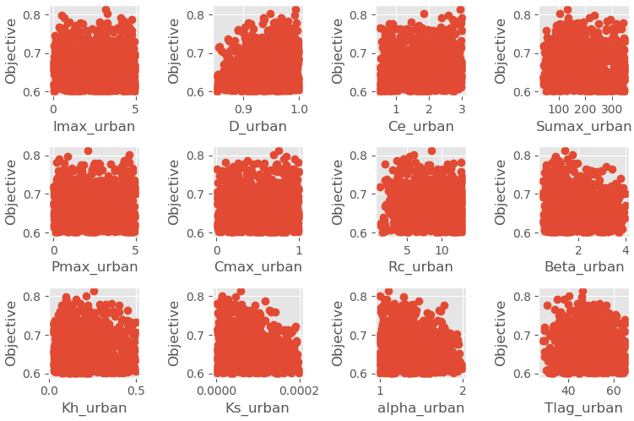
Modelling
d. Parameter calibration of lumped model
- Determine initial parameter intervals in semi-distributed model
parameter intervals, rather than specific parameter value;
Realistic range;
capture the objective function larger than 0.6
Lumped models for rural and urban sub-catchments
Semi-distributed model for study catchment
The expression of LID practices in model
Figure 109. Parameter Calibration Result of Urban Lumped M05B (The parameter intervals, which could capture the objective function larger than 0.6, were reserved and used to determine the initial parameter interval in semi-distributed model.)
Notes:
No specific parameter value would be selected from this calibration result but the parameter intervals, which could capture the objective function larger than 0.6, were reserved and used to determine the initial parameter interval in semi-distributed model

Slide 23
Modelling
e. The hydrological difference between urban sub-catchment
and study catchment (Human activities vary a lot by region)
- Determine initial parameter intervals in semi-distributed model
Lumped models for rural and urban sub-catchments
Semi-distributed model for study catchment
The expression of LID practices in model
Precipitation distribution factor (D): construction degree
Discharge coefficient of HR (Kh): water conveyance efficiency
Recharge coefficient (Rc): uneven groundwater recharge
Discharge coefficient of SR (Ks): groundwater stock in SR
Notes:
The calibration intervals of some para in semi should be changed.

Slide 24
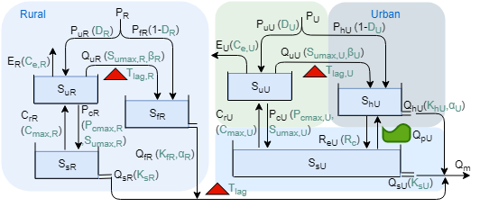
Modelling
a. Key elements in semi-distributed model
Lumped models for rural and urban sub-catchments
Semi-distributed model for study catchment
The expression of LID practices in model
Time lag for rural area, since the position of rural area (Initial interval: 1.25 - 10 hours)
Human activity module for urban area
Constraints on parameter limitation

Slide 25
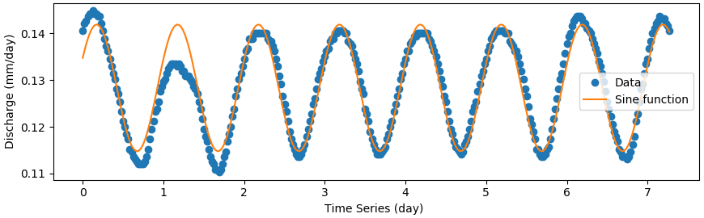
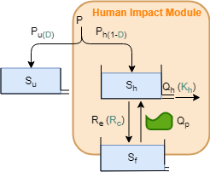
Modelling
Figure 16. The calibration result of water pumping process
a. Key elements in semi-distributed model
Lumped models for rural and urban sub-catchments
Semi-distributed model for study catchment
The expression of LID practices in model
Time lag for rural area (Initial interval: 1.25 - 10 hours)
Human activity module for urban grey areas (impervious areas)
Constraints on parameter limitation
Precipitation on
urban green areas
Precipitation on
urban grey areas
Discharge from urban pipeline system
Groundwater
recharge
Groundwater
pumping
Figure 17. Schematic figure of designed Human Impact Module
Notes:
HR: human impact reservior

Slide 26
Modelling
a. Key elements in semi-distributed model
Lumped models for rural and urban sub-catchments
Semi-distributed model for study catchment
The expression of LID practices in model
Time lag for rural area (Initial interval: 1.25 - 10 hours)
Human activity module for urban area
Constraints to avoid unrealistic combination of parameters
1. P_{max,R} > P_{max,U} (The maximum percolation velocity)
2. S_{umax,R} > S_{umax,U} (The maximum unsaturated storage depth)

Slide 27
M01A |  | M03A
(6R) |  | (7R)
M01B |  | M03B
M02 |  | M04
(7R) |  | (8R)
Interception
Reservoir
Interception
Reservoir
Riparian
Reservoir
RR & IR
Notes:
b. Model structure generation of Semi-distributed model

Slide 28
M01A |  | M03A
M01B |  | M03B
M02 |  | M04
D-Prec. Dist. coefficient
D-Prec. Dist. coefficient
Notes:
b. Model structure generation of Semi-distributed model

Slide 29
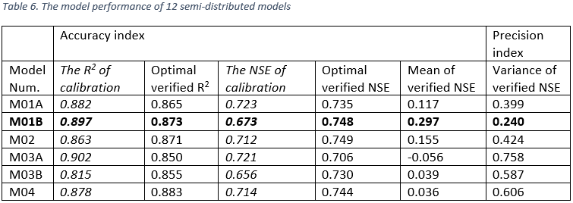
Modelling
c. Selection of Semi-distributed model
Lumped models for rural and urban sub-catchments
Semi-distributed model for study catchment
The expression of LID practices in model
The selection of model structure
The determination of propriate parameter set

Slide 30
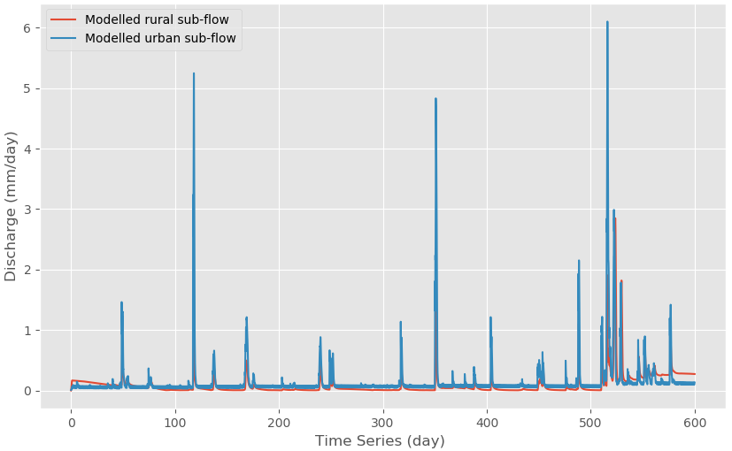
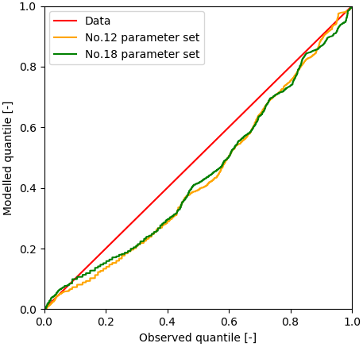
Modelling
c. Selection of Semi-distributed model
Lumped models for rural and urban sub-catchments
Semi-distributed model for study catchment
The expression of LID practices in model
The selection of model structure
The determination of propriate parameter set:
1. The performance on sub-flows and basin peak runoff
2. Distribution analysis (QQ plots)

Slide 31
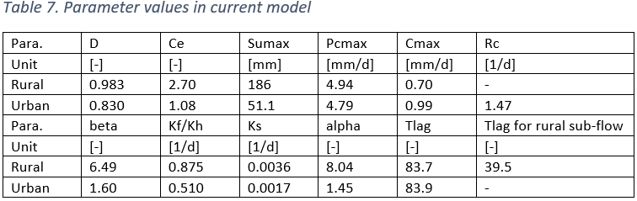
Modelling
d. The final selection of rainfall-runoff semi-distributed model for current condition
Lumped models for rural and urban sub-catchments
Semi-distributed model for study catchment
The expression of LID practices in model

Slide 32
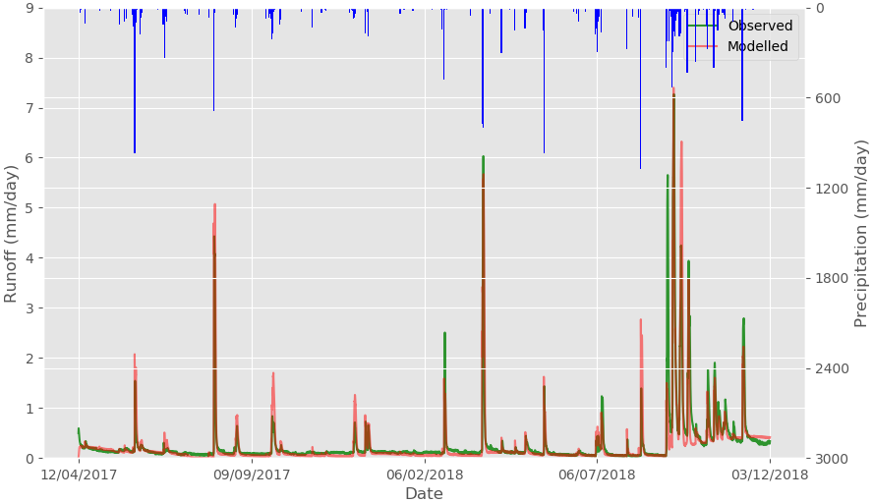
Modelling
d. The final selection of rainfall-runoff semi-distributed model for current condition
Lumped models for rural and urban sub-catchments
Semi-distributed model for study catchment
The expression of LID practices in model

Slide 33
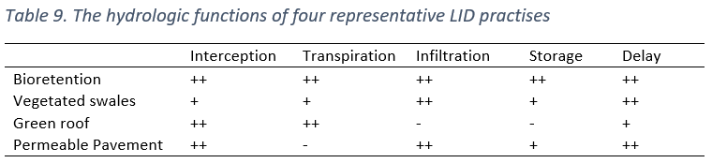
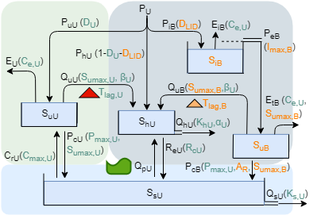
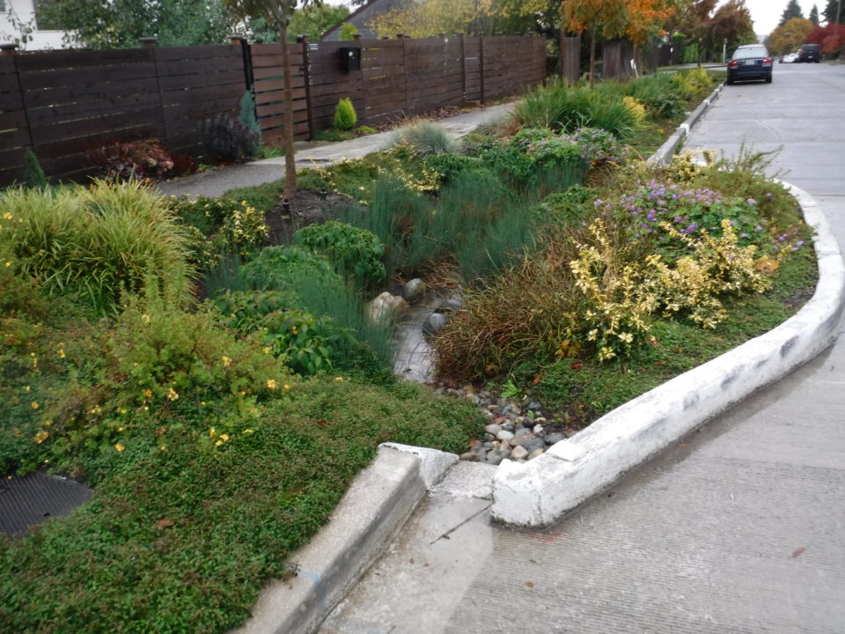
Modelling
a. Qualitative hydrologic routes of four representative LID practices
(Bioretention cells as example)
Lumped models for rural and urban sub-catchments
Semi-distributed model for study catchment
The expression of LID practices in model
Symbols: ++ major function; + accessory function; - insignificant function;
Interception
delay
transpiration
storage
infiltration

Slide 34
Modelling
b. Quantitative parameters estimation
1. Precipitation distribution factor (D_{LID});
2. The ratio of drainage area to construction area (A_{R});
3. The maximum interception depth (I_{max,B}): 3.5 mm
- 0.6 to 4.6 mm, field tests in Maryland, U.S. (Li et al , 2009);
4. The maximum water storage depth in soil layer (S_{umax}): 300 mm
- “SARA LID Guidance Manual” recommends 0.6 - 1.2 m soil media depth;
- Empirical soil porosity as 0.35 for moderately permeable local soil;
5. Time lag coefficient of bioretention cells (T_{lagB}): 3h
-according to a field test result, peak flow could be delayed by 3 hours by bioretention cells (Hunt., 2008);
Lumped models for rural and urban sub-catchments
Semi-distributed model for study catchment
The expression of LID practices in model

Slide 35
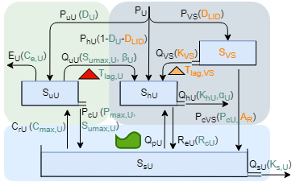
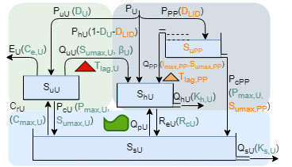
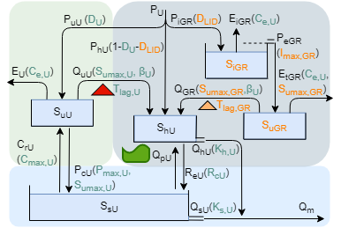
Modelling
 | Vegetated Swales
Pervious pavements
 | Green Roofs
Lumped models for rural and urban sub-catchments
Semi-distributed model for study catchment
The expression of LID practices in model
Notes:
With the same procedures, the modules for the another three representative LID practices are designed

Slide 36
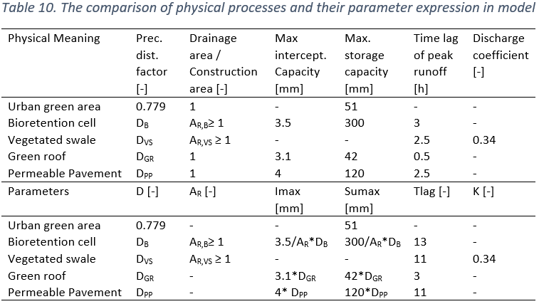
Modelling
The expression of LID practices in model: the parameter estimation results of four LID practices

Slide 37
The influence of Low Impact Development on rainfall-runoff relationships at catchment scale
Introduction
Modelling
Scenarios
Results
Discussions
Conclusions
Recommendations

Slide 38
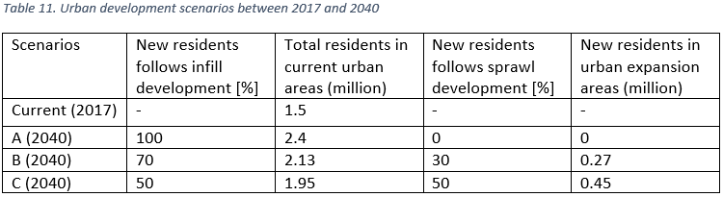
Scenarios
a. Scenarios design of urban development
Urban development scenarios
LID implementation scenarios
Population Forecast: 2.4 million in 2040
Urban development strategy: Higher density, less expansion; since the former unconstrained outward urban expansion has led to disinvestment in the urban core areas and high cost of infrastructure and utility service
Notes:
3 urban development scenarios are designed according to different urban expansion extent

Slide 39
Scenarios
Urban development scenarios
LID implementation scenarios
b. The expression of urban development scenarios in model
The distribution of rural and urban areas;
The distribution of urban green and grey areas (D);
Two assumptions:
Uniform construction degree;
More infill urban development, less per capita urban grey areas: 3 estimate ratios for the compaction degree of living space (0.85, 0.9, 1)
Notes:
Larger population density, the

Slide 40
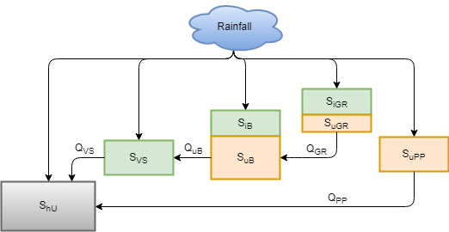
Scenarios
Five scenarios are formulated and tested based on the urban development scenario C (half infill and half sprawl strategy).
Bioretention: 15% (precipitation on urban grey areas);
Vegetated Swales: 15%;
Green roofs: 15%;
Pervious pavement: 15%;
Mixed LID scenario: Bioretention cells 15% (A_{R} = 1.5); Vegetated swales 15% (A_{R} = 3); green roofs 5%; permeable pavements 15%; Cascade connection among LID practices;
A_{R}: the ratio of drainage areas and construction areas
Urban development scenarios
LID implementation scenarios
Notes:
The first four LID scenarios are aim to compare the different hydrologic performances of LID practices; the ratio of drainage areas and construction areas

Slide 41
The influence of Low Impact Development on rainfall-runoff relationships at catchment scale
Introduction
Modelling
Scenarios
Results
Discussions
Conclusions
Recommendations

Slide 42
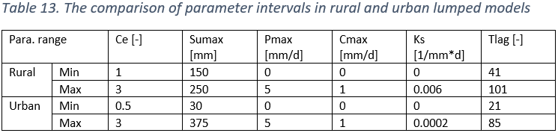
Results
a. The parameters calibration result of rural and urban lumped models
Q1: The different rainfall-runoff relationship of urban and rural areas
Q2: Urbanization influences
Q3: LID implementation influences
Q4: The time approaching and stacking of urban and rural peaks due to LID implementation
Evaporation
correction
coefficient
Maximum
unsaturated
storage
Slow groundwater
flow
coefficient
Time lag
coefficient
 | Evaporation | Water storage | Runoff delay
Rural | + | + | +
Urban | - | - | -
Groundwater flow
+
-
Symbols: + strong; - weak;
Notes:
Most of the four parameters for urban areas are smaller than them for rural areas; and these four parameters quantified the E/S/D/GF ability. Therefore with less E/S/D, urban peak larger than rural peak; With less gw recharge, the urban base flow will less than rural base flow.

Slide 43
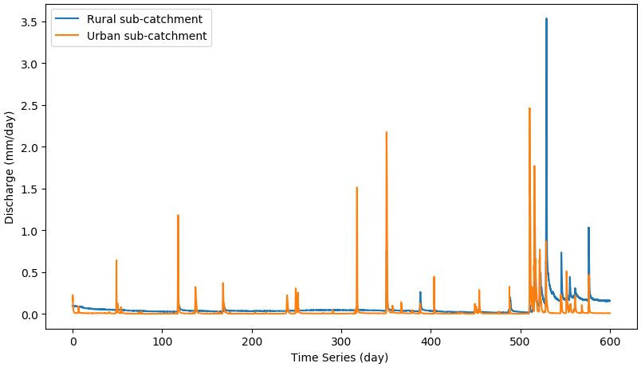
Results
Q1: The different rainfall-runoff relationship of urban and rural areas
Q2: Urbanization influences
Q3: LID implementation influences
Q4: The time approaching and stacking of urban and rural peaks due to LID implementation
b. The comparison of rainfall-runoff relationship of urban and rural areas
In general, the runoff from rural areas performs more moderate than it from urban areas.
Urban: varies between extreme flood and extreme drought;
Rural: the peak flows seldom happen in dry seasons, but in flood season, the magnitude of peaks may be great.
(And the presence of peak runoff is always accompanied with the increase of base flow caused by large groundwater stock.)

Slide 44
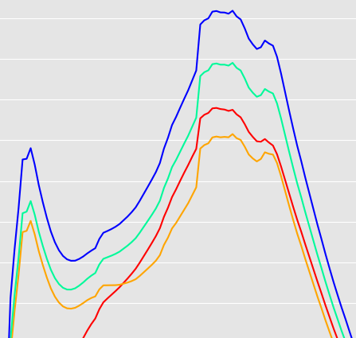
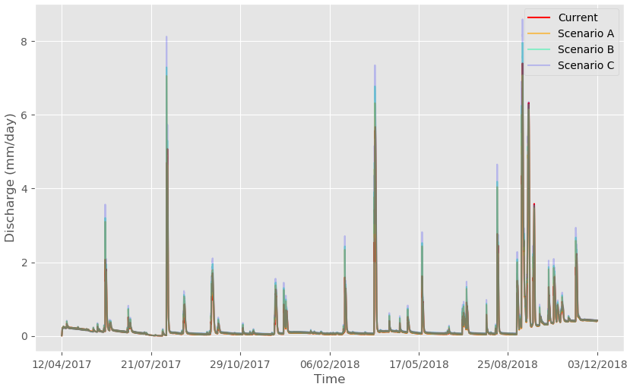
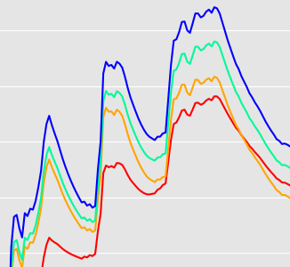
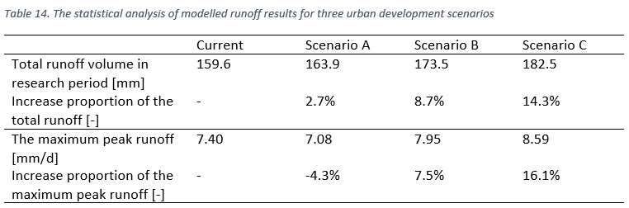
Results
The maximum peak runoff
Q1: The different rainfall-runoff relationship of urban and rural areas
Q2: Urbanization influences
Q3: LID implementation influences
Q4: The time approaching and stacking of urban and rural peaks due to LID implementation
Figure 32. The total basin runoffs of the three urban developed scenarios

Slide 45
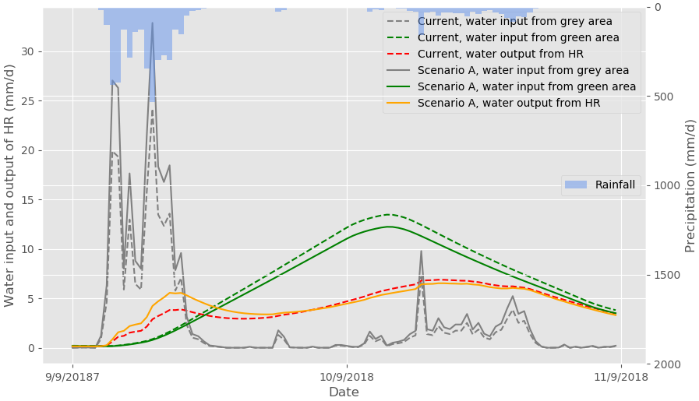
Results
The decrease of extreme peak flow in Scenario A
Scenario A: has larger urban grey areas and less urban green areas
Small to medium peaks: only generate from urban grey areas, increase;
Extreme large peaks in flood season: mainly generate from large area of urban green surface (and rural areas), decrease;
Q1: The different rainfall-runoff relationship of urban and rural areas
Q2: Urbanization influences
Q3: LID implementation influences
Q4: The time approaching and stacking of urban and rural peaks due to LID implementation
Figure 34. The water input and output of urban drainage system (HR) in current situation and urban development scenario A
Notes:
abnormal phenomenon could be explained by the generation mechanism of peak runoffs; this argument can be proved with this figure; And the output of HR is the main resource of urban runoff. therefore with A, the first vertex increased but the second larger peak decrease.

Slide 46
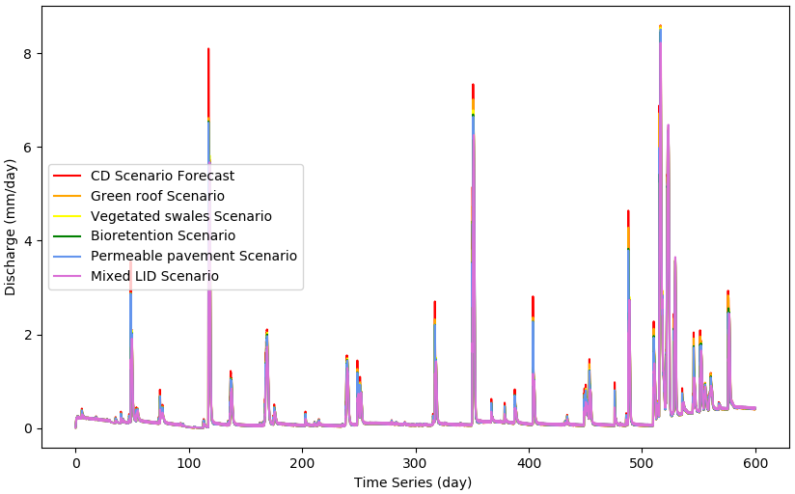
Results
a. Less effective on basin peak runoff reduction in flood season
Reason 1. LID practices influence urban grey areas; however peaks in flood season are generated from rural and urban green areas.
Reason 2. Intensive rainfalls take up most space of LID practices and exhaust the water retention capacity.
Q1: The different rainfall-runoff relationship of urban and rural areas
Q2: Urbanization influences
Q3: LID implementation influences
Q4: The time approaching and stacking of urban and rural peaks due to LID implementation
Figure 35. The total basin runoff of five LID scenarios and the CD scenario
Notes:
Several characteristics of LID performance are founded here

Slide 47
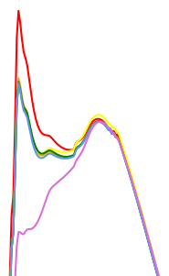
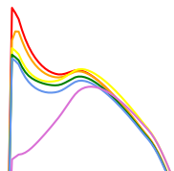
Results
b. LID practices have more significant effect on the first vertex
The first peak vertex mainly generates from urban grey areas;
The second vertex mainly generates from large areas of urban green surface or rural areas, which are not the “domain” of LID.
Q1: The different rainfall-runoff relationship of urban and rural areas
Q2: Urbanization influences
Q3: LID implementation influences
Q4: The time approaching and stacking of urban and rural peaks due to LID implementation
Typical extreme peak
Figure 35. The total basin runoff of five LID scenarios and the CD scenario

Slide 48
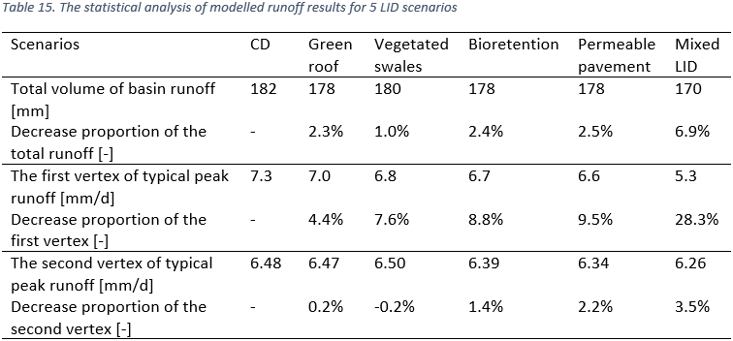
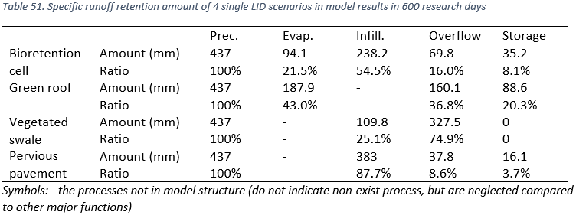
Results
c. The comparison of 4 LID practices
(the first 4 scenarios with single LID practices)
Bioretention cells, pervious pavements: forceful runoff volume and peak runoff reduction ability;
Vegetated Swales: weak runoff volume reduction ability;
Green Roofs: weak peak runoff reduction ability, lose function in flood seasons, since small water retention capacity.
Q1: The different rainfall-runoff relationship of urban and rural areas
Q2: Urbanization influences
Q3: LID implementation influences
Q4: The time approaching and stacking of urban and rural peaks due to LID implementation

Slide 49
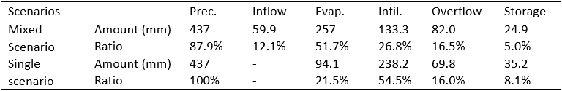
Results
d. More water input and less construction areas for bioretention cells
(Mixed scenario & Bioretention scenario)
The ratio of overflow kept the same
Infiltration decreases: less construction areas ;
Evaporation (Interception and transpiration): better developed.
Great runoff reduction potential, especially evaporation;
Q1: The different rainfall-runoff relationship of urban and rural areas
Q2: Urbanization influences
Q3: LID implementation influences
Q4: The time approaching and stacking of urban and rural peaks due to LID implementation
Table 54. Performance comparison of bioretention cells in mixed LID scenario and single bioretention scenario
 | Drainage area (of urban grey area) | Construction area (of urban grey area) | Water input (mm)
Mixed scenario | 15% | 10% | 497
Bioretention scenario | 15% | 15% | 437
Notes:
The hydrological performance of bio could further explored by comparing bio scenario and mixed LID scenario. In mixed,

Slide 50
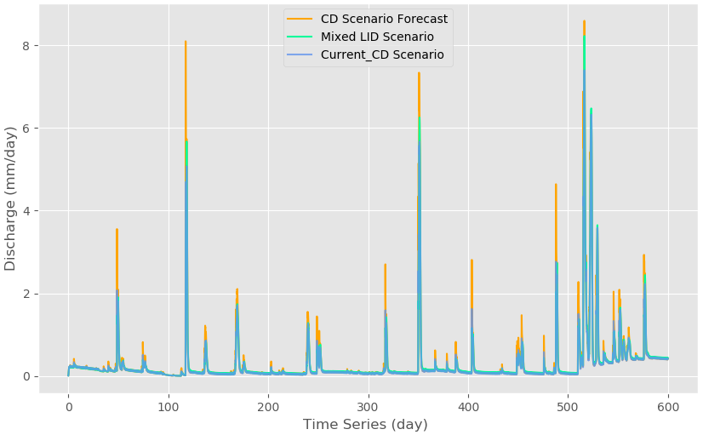
Results
e. Mixed LID scenario (based on urban development scenario C)
Most peaks (generating from urban grey areas) are controlled well.
Extreme large peaks in flood season (also generating from rural and urban green areas): the peak reduction ability was restrained significantly; But larger extent of infill urban development strategy (like scenario A) could be used to solve this problem;
Q1: The different rainfall-runoff relationship of urban and rural areas
Q2: Urbanization influences
Q3: LID implementation influences
Q4: The time approaching and stacking of urban and rural peaks due to LID implementation
Table 55. Model results of the total basin runoff in mixed LID scenario, the current CD scenario and the CD scenario in 2040

Slide 51
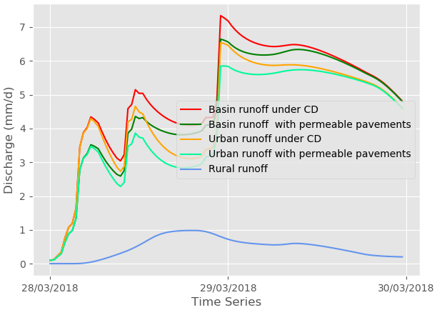
Results
a. Four scenarios with single LID practice
Time lags between LID and CD urban peaks: 0.5 - 2.5 hours;
(Time lags between rural peaks and CD urban peaks: 6.5 - 15.5 hours;)
delay ability < reduction ability, most basin peak runoffs decrease
Q1: The different rainfall-runoff relationship of urban and rural areas
Q2: Urbanization influences
Q3: LID implementation influences
Q4: The time approaching and stacking of urban and rural peaks due to LID implementation
Table 55. Model results of the total basin runoff in mixed LID scenario, the current CD scenario and the CD scenario in 2040

Slide 52
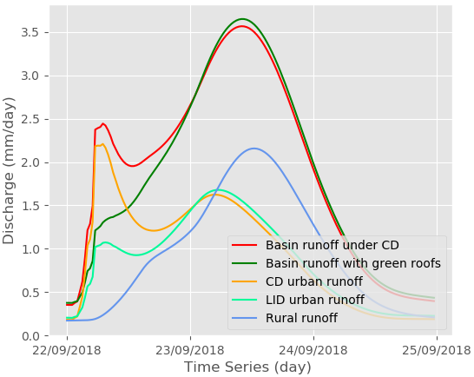
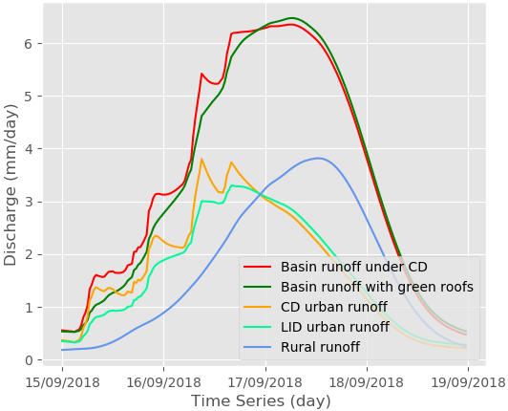
Results
b. The mixed LID practices scenario
Time lags between LID and CD urban peaks: 0.5 - 6.5 hours;
(Dry season: reduction ability > delay ability, basin peaks decrease)
Flood season: reduction ability < delay ability, basin peaks increase
Urban runoff (L): increased by 0.06 mm/d, from 1.62 to 1.68 mm/d;
Total basin runoff (L): increased by 0.08 mm/d, from 3.57 to 3.65 mm/d;
Total basin runoff (R): increased by 0.12 mm/d, from 6.35 to 6.47 mm/d.
Q1: The different rainfall-runoff relationship of urban and rural areas
Q2: Urbanization influences
Q3: LID implementation influences
Q4: The time approaching and stacking of urban and rural peaks due to LID implementation
Figure 40. The peak runoffs from rural, urban, and basin areas in mixed LID practices scenario and CD scenario
Notes:
. In conclusion we may say that the stacking effect of LID implementation on total basin runoff is limited in the case of San Antonio basin, partly due to the fact that only a small part of this basin is urbanized.

Slide 53
The influence of Low Impact Development on rainfall-runoff relationships at catchment scale
Introduction
Modelling
Scenarios
Results
Discussions
Conclusions
Recommendations

Slide 54
Discussions
a. Low complexity of model structure
Overlook the heterogeneity within the rural or urban areas;
Reliability and accuracy of the mathematical expressions of many artificial water processes (such as urban stormwater drainage, water pumping, and groundwater recharge) are arguable;
b. The model components inheritance from lumped to semi-distributed model
Some information may be lost;
c. Optimistic LID parameters estimation
Optimistic estimation of LID practices condition (such as 12-cm soil depth for extensive green roofs)
The negative events, such as the damage of LID practices, lack of daily maintenance or blockage problems of soil media, are neglected .
Model uncertainty
Scenario limitation
The comparability of research results and literatures about LID

Slide 55
Discussions
a. The limitation of urban development scenarios
Population forecast: 0.9 million new residents between 2017 and 2040;
Uniform construction degree;
3 estimate ratios for the compaction degree of living space (0.85, 0.9, 1).
b. The limitation of LID implementation scenarios
Uniform LID implementation;
Optimistic design: 50% of the precipitation on urban impervious surface is collected, and cascade connections for mixed LID scenarios.
Model uncertainty
Scenario limitation
The comparability of research results and literatures about LID
Notes:
Scenario limitations are mainly comes from the reliability of the forecast and assumption such as the population forecast and the assumption of uniform construction degree.

Slide 56
Discussions
a. The comparability of model result
b. Analysis comparability
Ineffective runoff reduction performance (total volume) of vegetated swales is ascribed to its fast rainwater transportation and short residence time (Huang, 2018).
Permeable pavement is the most hydrologically effective LID practice among the four test LID practices (Ahiablame, 2012).
Compared to single LID practices, the mixed of various LID practices should be promoted with better robustness (Qin, 2013; Askarizadeh, 2015; Fang, 2017; Huang, 2018).
The reduction of total runoff volume | Literatures (Resources) | This research
Bioretention cells | 48% - 97% (Chapman and Horner, 2010; DeBusk and Wynn, 2011) | 84%
Green roofs | 23% - 100% (VanWoert, 2005; Hathaway, 2008; Carpenter and Kaluvakolanu, 2011) | 63%
Permeable pavements | 50% - 93% (Rushton, 2001; Hunt, 2002; Dreelin, 2006) | 91%
Vegetated swales | 85% for small storms; 35% - 66% for large storms (Hunt, 2010) | 25% for all the storms in total
Model uncertainty
Scenario limitation
The comparability of research results and literatures about LID
Notes:
Most of the results are consistent with literatures. And for the result analysis, this research provides some similar arguments as literatures; such as

Slide 57
The influence of Low Impact Development on rainfall-runoff relationships at catchment scale
Introduction
Modelling
Scenarios
Results
Discussions
Conclusions
Recommendations

Slide 58
Conclusions
Since the specific conditions of study catchment, some quantitative conclusions of this research are limited in a restrained region.
Q1 :
Urban: varies between extreme flood and extreme drought;
Rural: more moderate, but in flood season peak runoffs may be large.
Q2 :
The infill urban development strategy is more helpful on runoff reduction than sprawl urban development strategy.
For the scenario C (half-infill and half-sprawl), the total runoff volume would rise by 14% compared to current situation. And for scenarios B (70%-infill and 30%-sprawl), the total runoff would rise by 9% in. As for scenario A (full infill development), this growth rate is only 3%.
For scenario C and scenario B, the peak runoff of a typical extreme peak increased by 16% and 8% than current situation, however scenario A even decreased the peak runoff by 4%.
Q1: The different rainfall-runoff relationship of urban and rural areas
Q2: Urbanization influences
Q3: LID implementation influences
Q4: The time approaching and stacking of urban and rural peaks due to LID implementation

Slide 59
Conclusions
Q3 :
LID practices are less effective on peak runoff reduction in flood season than dry season;
Bioretention cells and pervious pavements have forceful runoff reduction ability; The runoff volume reduction ability of vegetated swales is weak; Green Roofs performed worst on peak runoff reduction;
More water input and less construction areas could better develop the evaporation ability of bioretention cells;
Q4:
For four scenarios with single LID practice (15%), the peak delay is not significant, and therefore there is no obvious increase on basin peaks.
For the mixed LID scenarios (50%), the delayed urban runoff brings larger stack of rural and urban peaks and increases two basin peak runoffs in flood season from 3.57 to 3.65 mm/d and from 6.35 to 6.47 mm/d.
Q1: The different rainfall-runoff relationship of urban and rural areas
Q2: Urbanization influences
Q3: LID implementation influences
Q4: The time approaching and stacking of urban and rural peaks due to LID implementation

Slide 60
The influence of Low Impact Development on rainfall-runoff relationships at catchment scale
Introduction
Modelling
Scenarios
Results
Discussions
Conclusions
Recommendations

Slide 61
recommendations
The combination of various LID practices rather than single LID; and cascade connections among different LID practices
The infill development strategy is more helpful on runoff reduction than sprawl development strategy,
When making urban development and LID implementation plans, the time difference between the peak runoffs from the sub-areas (rural areas, urban grey and green areas; bare, grass, bush and tree areas) could be design by adjusting the area and position of sub-areas. Therefore, the basin peak runoffs could be controlled.
Future research could exploit distributed models to further explore the influence of heterogeneous urban condition (caused by urban drainage system, regional water police, partial construction degree and etc).
Recommendations for the suitable LID implementation
Recommendations and suggestions for future research
Notes:
Cascade connection, to better balance the different water retention capacity of LID practices.

Slide 62
The influence of Low Impact Development on rainfall-runoff relationships at catchment scale Thank you for your listening!
Xinxin Sui
MSc Water Management 2017-2019
TU Delft

